Slide 1
Introduction
to Application Security
& DevSecOps
Arthur Okedi
Cyber Security Analyst

Slide 2
Session Objectives
Define Application Security and its relevance to business.
Understand Software Development Lifecycle Stages
Explore DevOps and the need for DevSecOps.
Recognize the importance of Automation and Secure Coding
Review tools and demo common security flaws

Slide 3
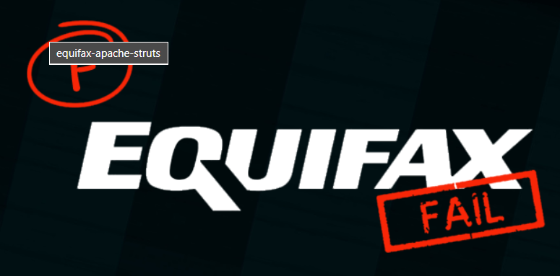
Real-World Hacks from Poor Security Practices
Equifax: Missed Apache Struts patch
Link: https://thehackernews.com/2017/09/equifax-apache-struts.html
Capital One: Misconfigured AWS firewall
https://thehackernews.com/2017/09/equifax-apache-struts.html
Log4Shell: Unsafe input in logs
https://www.upguard.com/blog/apache-log4j-vulnerability

Slide 4
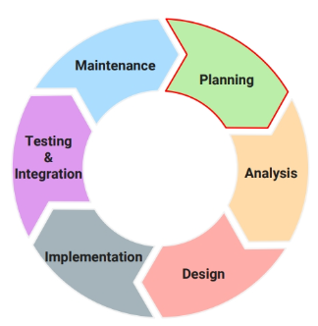
Software Development Lifecycle (SDLC)
Planning: This phase establishes the foundation for the entire development process.
Analysis: This phase focuses on gathering detailed information to fully understand the requirements of the application.
Design: This phase translates the requirements defined in the analysis phase into a technical blueprint for the application.
Development: This phase involves building the application based on the design specifications. Developers write code, create unit tests, and integrate different components of the application.
Testing and Integration: This phase focuses on thoroughly testing the application to identify and fix bugs and ensure it meets the requirements.
Deployment and Maintenance: Once rigorous testing is complete, the application is deployed to a production environment where it can be accessed by end-users.

Slide 5
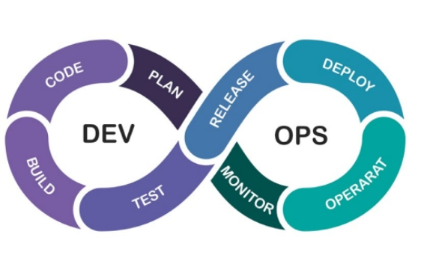
DevOps Methodology
DevOps is a collection of two words, “Development” and “Operations,” a methodology that emphasizes collaboration between development and operations teams.
The DevOps lifecycle includes different phases:
Plan: This stage involves defining the project goals and outlining the development process.
Code: Developers write and test the code for the software application.
Build: The code is compiled and assembled into a functional software program.
Test: The software is rigorously tested to identify and fix bugs. Release: The software is deployed to production for end-user consumption.
Operate: The software is monitored and maintained in production to ensure its performance and stability.
Monitor: Throughout the entire lifecycle, the software’s performance and health are continuously monitored.
Continuous Integration & Delivery (CI/CD): These practices automate the software building, testing, and deployment processes. This enables faster delivery and reduces the risk of errors.

Slide 6
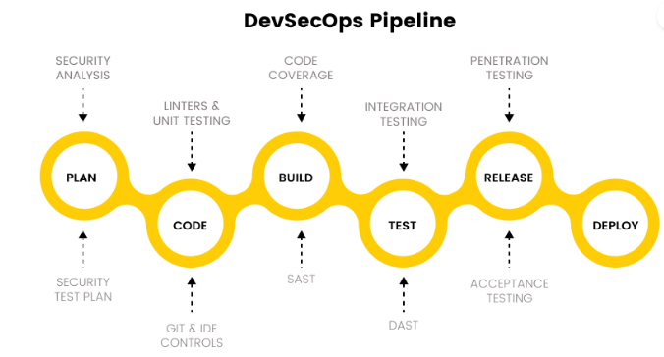
DevSecOps Methodology
DevSecOps extends the principles of DevOps by integrating security practices into every stage of the SDLC. It emphasizes “Shifting left” security, meaning that security considerations are addressed early in the development process rather than as an afterthought.

Slide 7
DevSecOps Methodology
DevSecOps principles are:
Collaboration
Security by Design - From the initial planning stages to coding, testing, and deployment.
Shift-Left Security - Security testing is shifted left in the development lifecycle, so that vulnerabilities are identified and addressed earlier in the process.
Automation
Continuous security

Slide 8
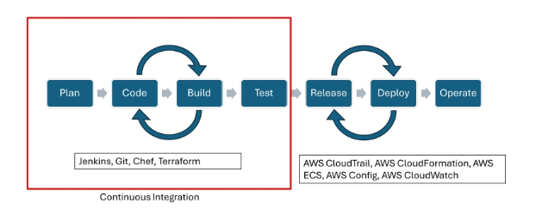
Shift-Left Security
Shift-Left Security approach aims to proactively identify and remediate security vulnerabilities during the development process, rather than relegating security testing to later stages or post-deployment.
Core Principles
Early and Continuous Integration
Developer Focus
Automation
Collaboration

Slide 9
Implementing Shift-Left Security
Security Training for Developers: Equipping developers with security best practices and coding guidelines fosters a security-conscious development culture.
Static Application Security Testing (SAST): Integrating SAST tools into the development workflow allows for automated scanning of code to identify potential vulnerabilities.
Software Composition Analysis (SCA): Utilizing SCA tools helps identify and manage vulnerabilities within third-party libraries and dependencies used in the software.
DevSecOps Integration: Breaking down silos between development, security, and operations teams enables seamless collaboration and promotes security awareness throughout the entire SDLC.

Slide 10
Software Composition Analysis
Is a method used in application security to identify and manage open-source components within a software project.
What SCA Involves
Identification of Components - Binaries, Source Code, and package managers (Look out for open-source components and dependencies)
Vulnerability Detection - Check our code against public vulnerability databases (like the National Vulnerability Database), with the aim to identify Security issues such as CVEs
License Compliance - Especially licenses of open-source components (e.g MIT, GPL, Apache. We are looking out for compatibility
Version Tracking - Ensures dependencies are upto date.

Slide 11

How SCA Fits Into DevSecOps
SCA is typically integrated into:
CI/CD pipelines (e.g., Jenkins, GitHub Actions) for automated scanning during builds.
Developer IDEs for real-time vulnerability alerts during coding.
Code repositories via plugins or Git hooks to prevent vulnerable code from being merged.

Slide 12
Secure Coding Practices
The practice of writing code that is resistant to Cyber Attacks.
Input Validation
Error Handling
Authentication and authorization
Encryption
Code Review
Manual and Automated Code Review

Slide 13
Common SCA Tools
OWASP Dependency-Check
Snyk
CodeQL - Github
Sonatype Nexus Lifecycle
Black Duck
WhiteSource (Mend)

Slide 14
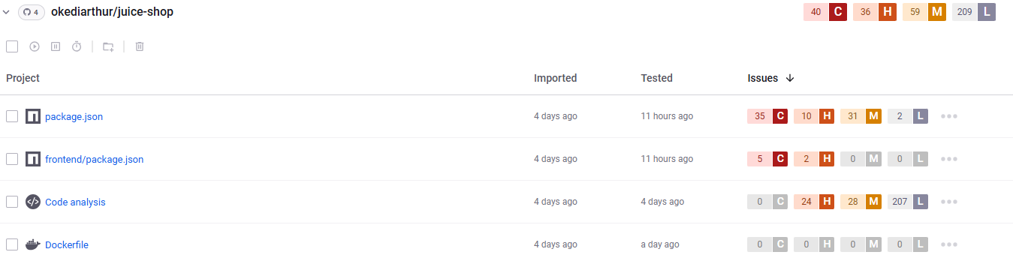
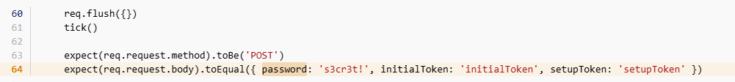
Example of SCA using Snyk

Slide 15
DevOps Vs DevSecOps
DevOps | DevSecOps
Fast Delivery | Fast + Secure Delivery
CI/CD | CI/CD + Security Checks
Developers + Ops | Developers + Security + Ops

Slide 16
Why Application Security Matters
Protects customer data
Prevents breaches
Prevent Financial Loss
Helps comply with regulations (GDPR, PCI-DSS)
Builds organizational trust and brand reputation

Slide 17



Final Thoughts
AppSec is a mindset.
Secure Code, Secure Pipelines
Start small, automate early, improve constantly

